Slide 1

JANI - Just in Time Assistant for Necessary Insights
"Smart, Secure, and Always Local"
21AIP76
Students Name:
B M Somashekar
Shreyas H S
Raghavendra Prasad G Shetti
Anjan S S
Guide name:
Dr. SHIVAPRASAD ASHOK CHIKOP
Asst. Professor, Dept. of AIML,
Department of AIML
Dayananda Sagar Academy of Technology & Management

Slide 2
Contents
Introduction
Problem Statement
Existing Systems
Literature Survey
System Architecture
Key Technologies
Experimental Analysis
Comparative Analysis
Future Work
Conclusion
References
Department of AIML
Dayananda Sagar Academy of Technology & Management

Slide 3
1. Introduction
JANI: Just in Time Assistant for Necessary Insights
Core purpose: AI-driven personal assistant maximizing user engagement through multi-modal functionality
Key differentiators:
Privacy-focused through local processing
Multi-modal interaction (voice, facial recognition, text)
Enhanced accessibility features
Personalized user experience
Performance highlights: 96% task completion rate
Target applications: Personal productivity and accessible computing
Department of AIML
Dayananda Sagar Academy of Technology & Management

Slide 4
2. PROBLEM STATEMENT
Limitations of current commercial assistants:
Privacy concerns with cloud-based processing
Limited contextual awareness
Restricted offline capabilities
Insufficient personalization options
Inconsistent accessibility features
Need for: A comprehensive, privacy-focused assistant that combines multiple AI technologies
Challenge: Delivering competitive performance while prioritizing local processing and user privacy
Department of AIML
Dayananda Sagar Academy of Technology & Management

Slide 5
3. EXISTING SYSTEMS
Commercial Voice Assistants:
Siri, Alexa, Google Assistant
Primarily cloud-based processing
Limited privacy controls
Strong voice recognition (91-93%)
Fast response times (1.2-1.5 seconds)
Restricted offline functionality
Minimal customization options
Limited multi-modal interaction
Current Limitations:
Data privacy concerns
Dependency on internet connectivity
Limited personalization options
Restricted third-party integration
Department of AIML
Dayananda Sagar Academy of Technology & Management

Slide 6
4.LITERATURE SURVEY
Research Area | Key Findings | References
Commercial Voice Assistants: | Cloud-based processing for speech recognition | Effective but raise privacy concerns [2, 3]
Privacy-Focused Approaches: | Local processing minimizes server data sharing [4] | Open-source initiatives (e.g., Mycroft AI) [5]
Multimodal Interaction Research: | Combined audio, vision, and text inputs [6] | Hybrid systems with computer vision integration [7]
Accessibility Advancements: | Specialized assistants for users with disabilities [8] | IoT integration improving accessibility [9]
Department of AIML
Dayananda Sagar Academy of Technology & Management

Slide 7
5. System Architecture
Modular Design with Four Key Components:
Frontend Layer: Web application with authentication and chatbot interface
Face Authentication Backend (Flask): Biometric security system
Command Backend (FastAPI/Uvicorn): Voice command processing and system tasks
Chat Backend (Colab/Ngrok): Dual AI models for different conversation types
Design Philosophy:
Distributed architecture with specialized backends
Authentication-first security approach
Multi-modal input handling (text, voice)
Dual chatbot processing pipeline with context-aware routing
Cross-service communication with clear API boundaries
Data Flow:
Authentication flow: Image capture → Face comparison → Auth response
Command flow: Voice input → Intent parsing → System task execution
Chat flow: Message routing → Model selection (Phi 1.5 or JANI) → Response generation
Department of AIML
Dayananda Sagar Academy of Technology & Management

Slide 8
System Flowchart
Department of AIML
Dayananda Sagar Academy of Technology & Management

Slide 9
6. Key Technologies
Feature | Technology Used | Purpose
Voice Processing | webkitSpeechRecognition | Query recognition & response action.
Face Recognition | MTCNN + OpenCV | Secure authentication.
Task Automation | PyAutoGUI | App/web automation.
Privacy | Fernet Encryption | Local data security.
Department of AIML
Dayananda Sagar Academy of Technology & Management

Slide 10
Demo
Department of AIML
Dayananda Sagar Academy of Technology & Management

Slide 11
7. Experimental Results
Voice Command Recognition:
95.8% accuracy in quiet environments
91.3% in moderate noise
84.7% in high noise
1.6 seconds average response time
Facial Recognition Performance:
98.3% authentication accuracy (normal lighting)
3.2% false acceptance rate
0.5% false rejection rate
97.8% liveness detection accuracy
Task Automation:
96.4% success for application launch
94.8% for web search
93.7% for file operations
95.0% overall success rate
Department of AIML
Dayananda Sagar Academy of Technology & Management

Slide 12
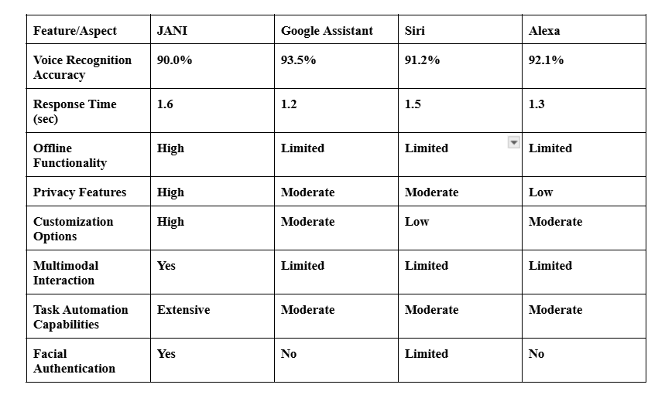
8. Comparative Analysis
Department of AIML
Dayananda Sagar Academy of Technology & Management

Slide 13
9. Future Work
1. Enhanced NLP Capabilities
Improve natural language understanding for more complex queries and contextual awareness.
2. Advanced AI Integrations
Incorporate LLMs (e.g., GPT, Gemini) to enhance response accuracy and versatility.
Implement real-time learning to adapt to user preferences over time.
3. Improved Multimodal Interactions
Enhance voice recognition accuracy across different accents and languages.
Sign Language Detection: Integrate computer vision models to recognize and translate sign language into text/speech for accessibility.
4. Cross-Platform Compatibility
Develop mobile and web-based versions for wider accessibility.
Enable seamless integration with smart home devices and IoT applications.
5. Security & Privacy Enhancements
Implement end-to-end encryption for secure user interactions.
Department of AIML
Dayananda Sagar Academy of Technology & Management

Slide 14
10. Conclusion
Summary of Achievements:
JANI AI successfully integrates voice-based interactions, web automation, and multimedia handling into a single AI-powered assistant.
The system demonstrates competitive performance in response time, task automation, and multimodal interactions.
Key Takeaways:
High offline functionality compared to existing assistants.
Enhanced security with facial authentication.
Extensive automation capabilities for user convenience.
Future Outlook:
Continuous improvements in NLP, multimodal AI, and real-time learning.
Expansion towards sign language detection and smart home integration.
Department of AIML
Dayananda Sagar Academy of Technology & Management

Slide 15
11. REFERENCES
B. M. Somashekar, S. H. S, R. P. G. Shetti, and A. S. S, "Just-in-Time AI Assistant: A Review," Int. Adv. Res. J. Sci. Eng. Technol., vol. 12, no. 2, pp. 109–115, Feb. 2025.
T. Borkute, S. Karne, A. Lahariya, A. Chandewar, and S. Bhanse, "JARVIS - Just A Rather Intelligent System," Int. J. Res. Eng. Sci., vol. 10, no. 5, pp. 45-50, May 2022.
F. Aslam, "The Impact of Artificial Intelligence on Chatbot Technology," Eur. J. Technol., vol. 7, no. 3, pp. 62-72, Aug. 2023.
A. Wali, S. Mahamad, and S. Sulaiman, "Task Automation Intelligent Agents: A Review," Future Internet, vol. 15, no. 6, Art. no. 196, May 2023.
B. Gupta, "Face Recognition Techniques - A Review," Department of Computer and Electrical Engineering, Wollega University, Ethiopia, 2023.
G. Preethi, A. K., T. S., and V. D. A., "Voice Assistant using Artificial Intelligence," Int. J. Eng. Res. Technol., vol. 11, no. 5, pp. 765-770, May 2022.
A. Vaswani et al., "Attention Is All You Need," in Advances in Neural Information Processing Systems (NeurIPS), 2017.
T. Wolf et al., "Transformers: State-of-the-Art Natural Language Processing," in Proceedings of the 2020 Conference on Empirical Methods in Natural Language Processing (EMNLP), 2020.
J. Devlin, M. Chang, K. Lee, and K. Toutanova, "BERT: Pre-training of Deep Bidirectional Transformers for Language Understanding," in Proceedings of NAACL-HLT, 2019.
H. Touvron et al., "LLaMA: Open and Efficient Foundation Language Models," arXiv preprint arXiv:2302.13971, 2023.
Department of AIML
Dayananda Sagar Academy of Technology & Management

